Slide 1
Team 5
Feed Amalgamator

Slide 2
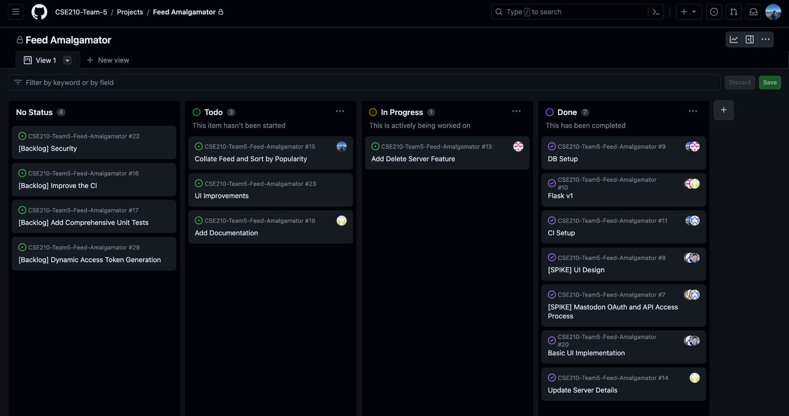
Kanban Board
https://github.com/orgs/CSE210-Team-5/projects/1/views/1

Slide 3
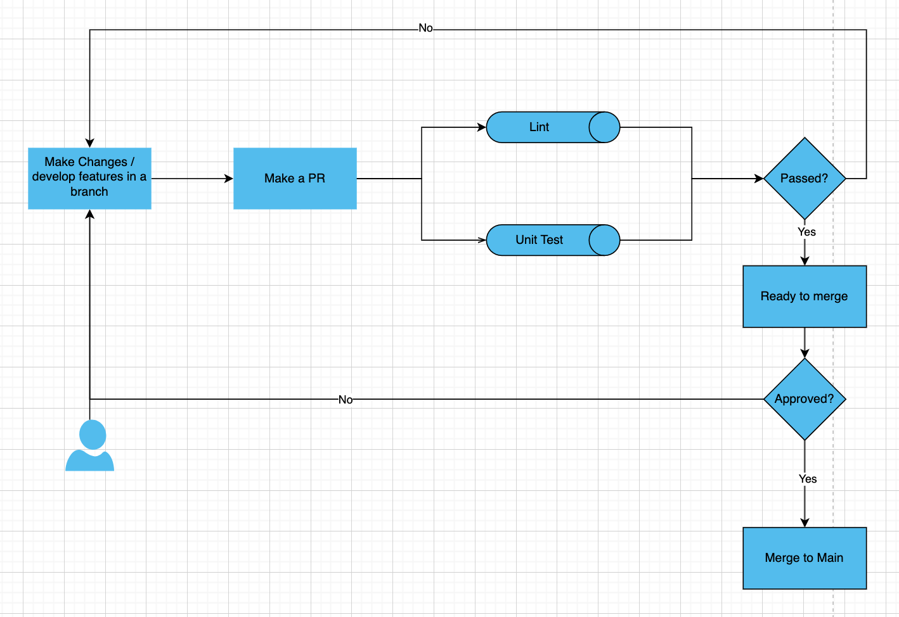
CI
Linting is in place, WIP to integrate python unit tests to the pipeline.

Slide 4
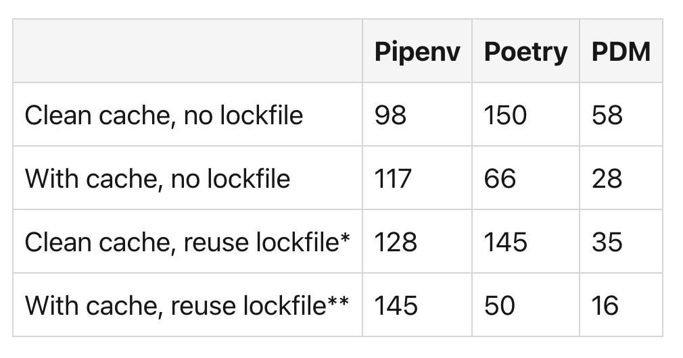

PDM
What is it?
Python package and dependency manager
Why is it better?
Better Performance
Better dependency resolution.
[Source: https://dev.to/frostming/a-review-pipenv-vs-poetry-vs-pdm-39b4]

Slide 5
Flask - The Software Engineering Aspect
Flask offers several advantages that align with Software Engineering principles
Separation of Concerns : Flask uses the Jinja2 templating engine, promoting the separation of business logic and presentation.
Modularity : Developers can choose and integrate different components, libraries, and extensions based on their project requirements.
Widely Compatible : Flask can be integrated with various databases, front-end frameworks, and other tools
Testing : Flask provides built-in support for testing, allowing developers to write unit tests for their applications more easily

Slide 6
Demo

Slide 7
What’s going well
Project was well scoped. Each feature is “bite sized”, allowing for work to be done incrementally. Goal for a viable product seems achievable
Project members are involved and are able to provide feedback and discuss issues freely; psychological safety
Everyone seems to be learning quite a lot!

Slide 8
Issues
Members are generally inexperienced with using CI and adhering to it (merging multiple times per day), leading to some merge issues.
Reliance on third party API that can be janky and have unclear conditions
Code quality and style issues and differences - difficult to make code look like “one person wrote everything”

Slide 9
Questions?

